Slide 1
Transaction management
$

Slide 2
Table of content
Transaction
Transaction management
Acid Properties
States of Transaction
Serializability and concurrency control
Lock Based Protocols

Slide 3

What is transaction?
A transaction in DBMS (Database Management System) is a sequence of one or more operations (like insert, update, delete, etc.) that are treated as a single logical unit of work. A transaction must satisfy the ACID properties — Atomicity, Consistency, Isolation, and Durability — to ensure data integrity.

Slide 4
1. User inserts ATM card and enters PIN.
2. System verifies user credentials. 3. User enters withdrawal amount. 4. System checks if sufficient balance is available. 5. If balance is sufficient: 6. Deduct the amount from user's account. 7. Dispense cash to the user. 8. Generate transaction receipt. 9. Update bank transaction records. if any step fails, entire transaction is rolled back (no cash dispensed, no deduction made).
ATM cash withdrawal
$
$

Slide 5
Money transfer between two accounts
User initiates fund transfer from Account A to Account B.
System verifies:
Validity of both accounts.
Sufficient balance in Account A.
If valid:
Deduct amount from Account A.
Add amount to Account B.
Log the transaction in system records.
Send confirmation message to the user.
If any step fails, complete transaction is cancelled (no money is deducted or credited).

Slide 6
What is transaction management?
Transaction Management makes sure that database transactions (like saving or updating data) work properly by:
Keeping data safe – No partial or messed-up changes.
Following the rules – Everything stays accurate and valid.
Finishing the job – If something goes wrong, it undoes any incomplete steps.
Even if the system crashes or an error happens, the database stays correct and consistent.

Slide 7
ROLE OF ACID PROPERTIES
ACID properties ensures that a database stays safe and reliable when any transaction happens. And whenever there is big task in the database(like money transfer, booking or order placement) these 4 rules ensure that
Data should not be wrong.
if the system crashes in between, the data doesn’t get corrupted.
If multiple users are working together, there is no clash happen.

Slide 8
ACID PROPERTIES
ATOMICITY
CONSISTENCY
ALL or NOTHING
Atomicity ensures that all operations within a transaction are executed completely or not executed at all.
Consistency means that a transaction always brings the database from one valid state to another valid state. After a transaction, the data in the database must still follow all the rules (like balance limits, unique IDs, etc.).
ISOLATION
DURABILITY
Isolation means that each transaction is kept separate from others, so one transaction can't interfere with another. Even if transactions happen at the same time, they won't affect each other’s data.
Durability ensures that once a transaction is committed, its changes are permanent and will survive even if the system crashes or there is a power failure.

Slide 9
ATOMICITY
STEP 1
CHECK BALANCE IN Shivam’s AND Kashish’s Account
ROLLBACK
STEP 2
500 deducted from Shivam’s Account
STEP 3
500 added to Kashish’s Account
COMMIT

Slide 10


CONSISTENCY
2000
1000
Shivam
Kashish

Slide 11
CONSISTENCY
1500
1500
Shivam
Kashish

Slide 12
CONSISTENCY
2000
1000
Shivam
Kashish

Slide 13
CONSISTENCY
1500
1000
Shivam
Kashish

Slide 14
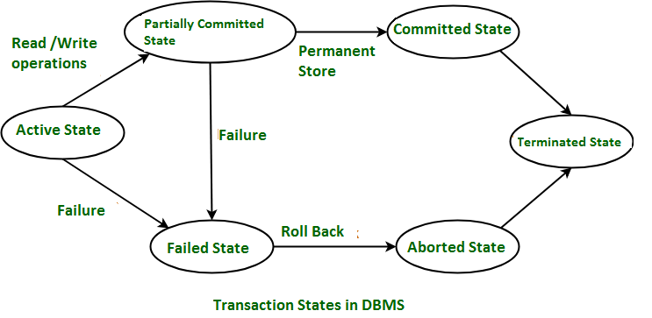
—Someone famous
Transaction states
$

Slide 15
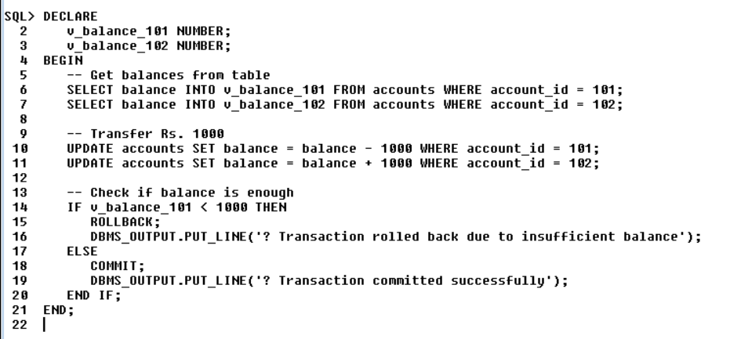
98,300,000
$
$

Slide 16
Isolation
Isolation
Concurrency Control
Serializilbity
Lock
Two PL
Timestamping
Shared Lock
Exclusive Lock
View
Conflict

Slide 17

What is Concurrency? Concurrency means handling multiple tasks simultaneously while ensuring correctness and consistency in the final outcome.
What is Serializability? Multiple transactions running at the same time, but the final output is the same as if they ran one-by-one in some order.

Slide 18
Types of Serializability
Conflict Serializability
View Serializability

Slide 19
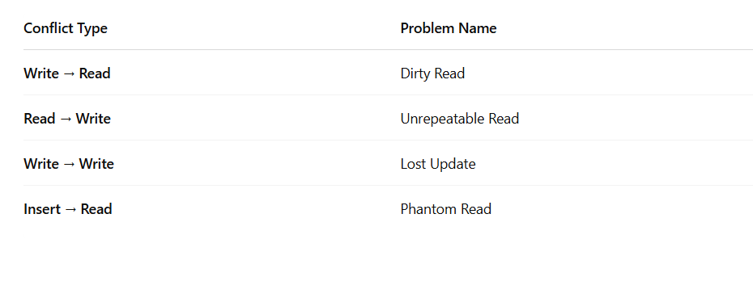
Conflict Types:

Slide 20
Table
Graph
 | T1 | T2
 | R(A)
 | W(A)
 |  | R(A)
 |  | W(A)
T1
T2
This is already a serial schedule

Slide 21
Table
Graph
 | T1 | T2
 |  | R(A)
 |  | W(A)
 | R(A)
 | W(A)
T1
T2
This is already a serial schedule

Slide 22
Table
Graph
 | T1 | T2
 | R(A)
 |  | R(A)
 |  | W(A)
 | W(A)
T1
T2
This creates loop
T1
T2

Slide 23
Table
 | T1 | T2 | T3
 |  | R(A)
 |  |  | R(A)
 |  |  | W(A)
 |  | W(A)
 | R(B)
 | W(B)
You need to make any one of these possibility
true to satisfy the serializability
T1 T2 T3
T1 T3 T2
T2 T3 T1
T2 T1 T3
T3 T1 T2
T3 T2 T1

Slide 24
Check this schedule is conflict serializable or not
T1 | T2 | T3
R(X)
 |  | R(Y)
 |  | R(X)
 | R(Y)
 | R(Z)
 |  | W(Y)
 | W(Z)
R(Z)
W(X)
W(Z)
T1 | T2 | T3
R(X)
 |  | R(Y)
 |  | R(X)
 | R(Y)
 | R(Z)
 |  | W(Y)
 | W(Z)
R(Z)
W(X)
W(Z)
Conflict Serializable
Serializable
Consistent
T1
T2
T3

Slide 25
To identify the possibility we will see the graph and find nodes with in-degree=0
T1
T2
T3
T2 has no in-degree
T1
T3
T2 T3 T1
T3 has no in-degree

Slide 26
Check this schedule is view serializable or not
T1 | T2 | T3
R(A)
 | W(A)
W(A)
 |  | W(A)
T1 | T2 | T3
R(A)
 | W(A)
W(A)
 |  | W(A)
First, we will identify whether this is conflict serializable or not.
This creates loop, it means this is not conflict-serializable
Now we’ll check through the view serialzable
T1
T2
T3

Slide 27
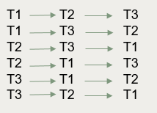
View serializable:
T1 | T2 | T3
R(A)
W(A)
 | W(A)
 |  | W(A)
T1 | T2 | T3
R(A)
 | W(A)
W(A)
 |  | W(A)
Now check based on view conditions
Initial read
Final write
Intermediate reads
Write all serial possibilities one by one.
S1 S2
IR | T1 | T1
FR | T3 | T3
IR | NO IR | NO IR
If both S1, S2 are equal then we can say that this is view serializable
And also this is serializable

Slide 28
Concurrency control is a mechanism for handling concurrent transactions
CONCURRENCY CONTROL

Slide 29
LOCKING
Locking is a concurrency control mechanism that restricts access to data when multiple transactions occur simultaneously.

Slide 30
LOCK TYPE
ROW
LOCKING
TABLE LOCKING
LOCK MODE
SHARED
LOCK
EXCLUSIVE LOCKING
SHARED
LOCKING
EXCLUSIVE LOCKING
TWO PHASE LOCKING
LOCK PROTOCOL

Slide 31
Growing Phase
TWO PHASE LOCKING (2PL)
Transaction can acquire locks (shared or exclusive).
Cannot release any lock.
This phase continues until the transaction acquires all the locks it needs.
Shrinking Phase
Transaction can release locks.
Cannot acquire any new lock.
Starts as soon as the first lock is released.

Slide 32
LOCK TYPE | BOOK DEFINITION
EXCLUSIVE LOCK | ONLY ONE USER CAN READ AND WRITE AT A TIME
SHARED LOCK | MULTIPLE TRANSACTIONS CAN READ, BUT NONE CAN WRITE TO THE LOCKED DATA.
ROW-LEVEL LOCK | LOCK IS APPLIED TO A SPECIFIC ROW, PREVENTING OTHER USERS FROM ACCESSING THAT ROW.
TABLE-LEVEL LOCK | THE ENTIRE TABLE IS LOCKED PREVENTING OTHER USERS FROM ACCESSING THAT TABLE.

Slide 33
ThankYou!
$
$

